Slide 1

GLOBAL WIRE
IMPROVEMENT ANALYSIS
Yingli Du 23906452
Wendi Luo 22553928
Yuanhao Ni 23986051
Vinayak Gupta 24066272
Tom Song 23054258

Slide 2



TABLE OF CONTENTS
Introduction
3 insights
Major Finding
Recommendation
Conclusion

Slide 3


Background
Global Wire Cable production company
key products, customers, and modes of transportation
replicated and enhanced
Recommendations
Potential economic benefits
INTRODUCTION
3 Insights

Slide 4
3 INSIGHTS
products
customers
modes of transportation
comparing the Product Family in the ProductGroup, the top 5 key products are selected, and then check the distribution in each state.
Then filter out the top 5 customers, and finally analyze the top 3 customers according to their state distribution and the products they produce
The actual transportation costs are compared and then the ones with high costs are changed.

Slide 5
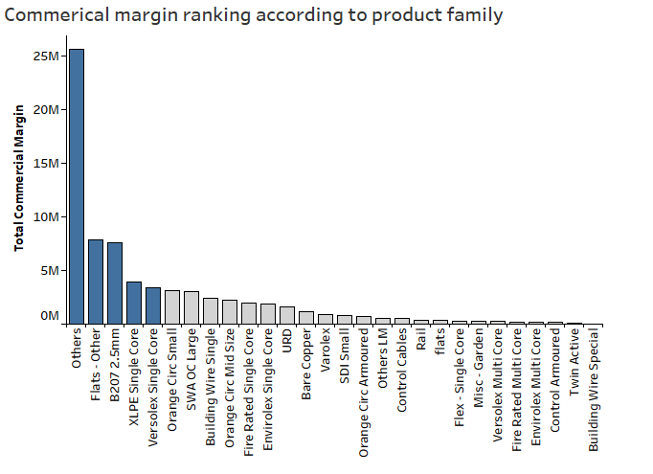
KEY INSIGHT 1 PRODUCT
Top 5 products in terms of the total commercial margin .
Others , Flats - Others , B 207 2.5mm, XLPE Single Core , Versolex Single Core.
Here others consists of different products whose product family is unknown but contributes largely in product margins. Analysis for this is done in further slides.

Slide 6
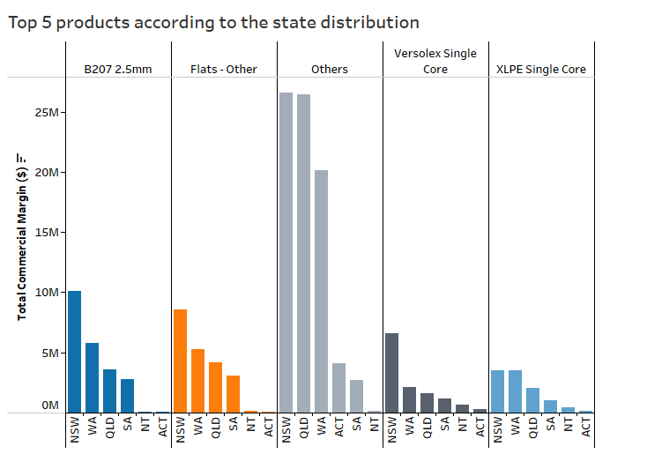
KEY INSIGHT 1 PRODUCT
Distribution of states with top 5 products.
B207 2.5 mm - doing really well in NSW, WA, QLD and poor in SA,ACT,NT
Flats - Other - Well in NSW,WA, QLD but poor in SA,ACT,NT.
Versolex - doing well in NSW but poor in other states.
XLPE single core - Doing well only in NSW,WA.

Slide 7
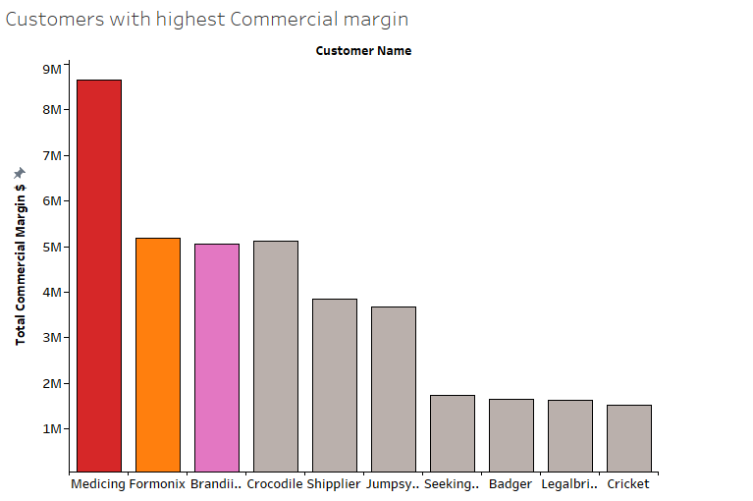
KEY INSIGHT 2 CUSTOMER
Top 10 customers in terms of the total commercial margin
Focusing on the following three companies:
Medicing: $8,654,979
Formonix: $5,183,621
Branding: $5,060,941

Slide 8
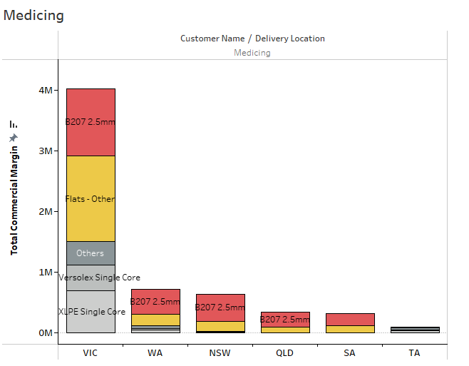
KEY INSIGHT 2 CUSTOMER
Distribution of total commercial margin of top 5 products for Medicing in each state
B207 2.5mm: $1,105,464(VIC) $443,493(NSW), $412,239(WA)
Flats-Others: $1,418,058(VIC), $166,370(NSW), $193,740(WA)

Slide 9
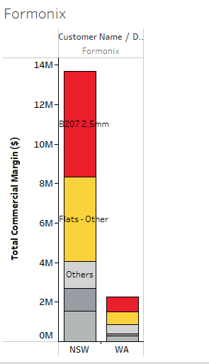
KEY INSIGHT 2 CUSTOMER
Distribution of total commercial margin of top 5 products for Formonix in each state
B207 2.5mm: $1,337,788(NSW), $96,826(WA)
Flats-Others: $1,064,977(NSW), $80,693(WA)

Slide 10
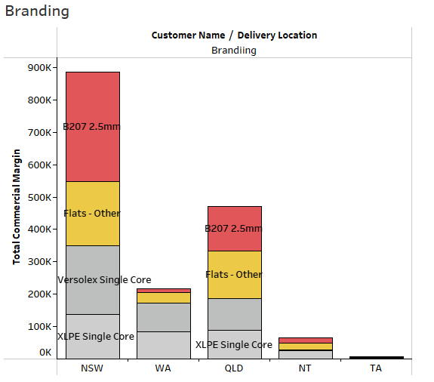
KEY INSIGHT 2 CUSTOMER
Distribution of total commercial margin of top 5 products for Brandiing in each state
B207 2.5mm: $338,538(NSW), $138,346(WA)
Flats-Others: $196,749(NSW). $146,096(WA)

Slide 11
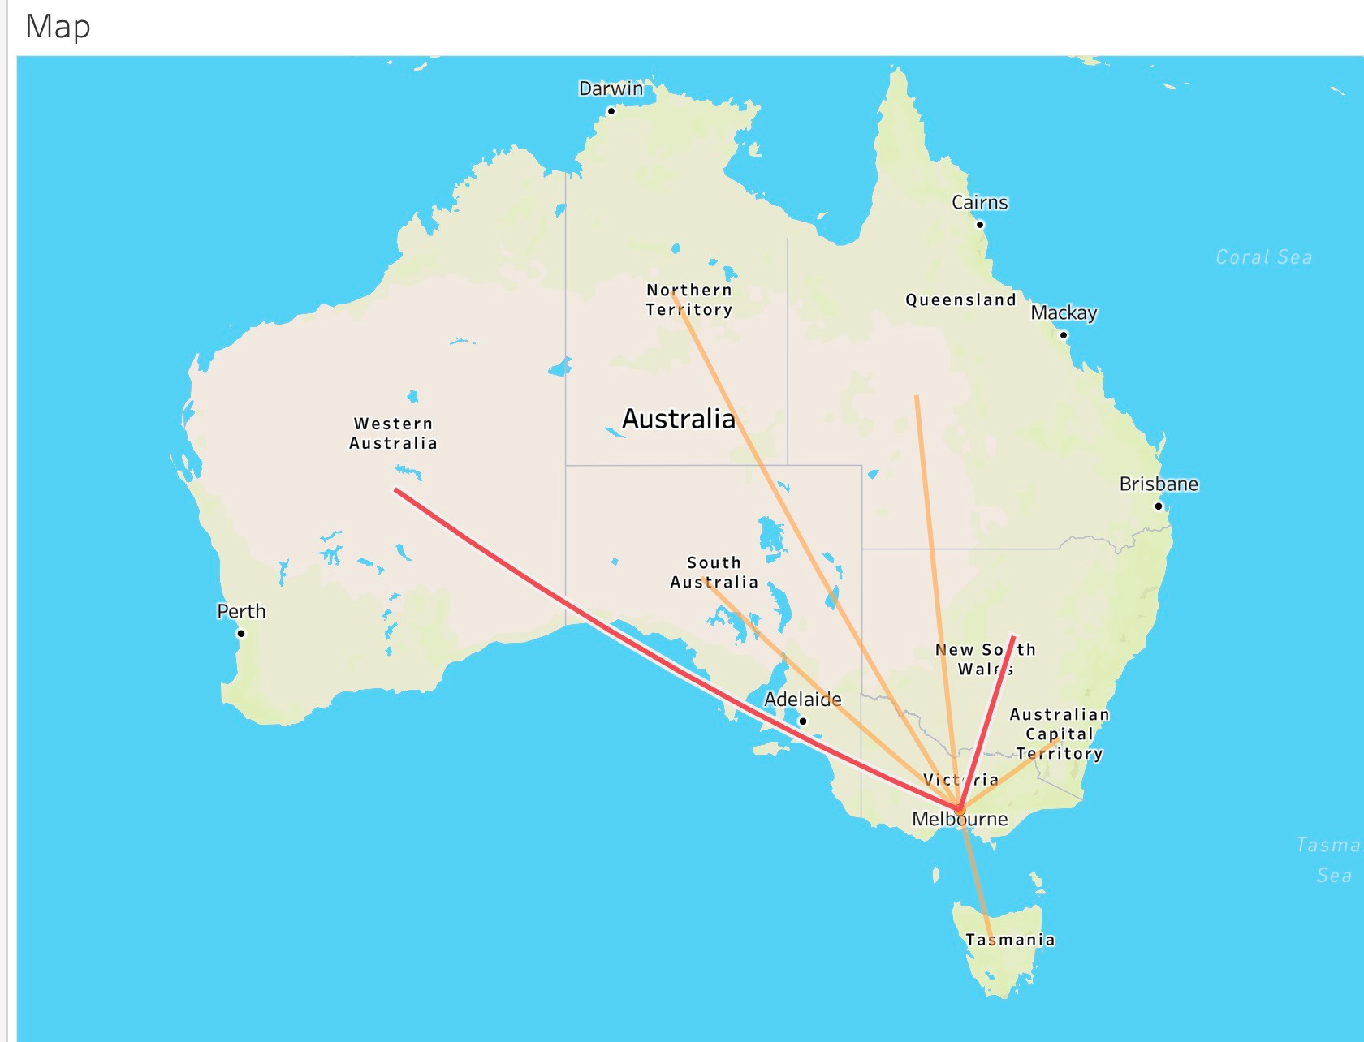

KEY INSIGHT 3
LOGISTICS
ROUTE
VIC - NT
VIC - SA
VIC - QLD
VIC - TA
VIC - ACT
VIC - WA
VIC - NSW

Slide 12
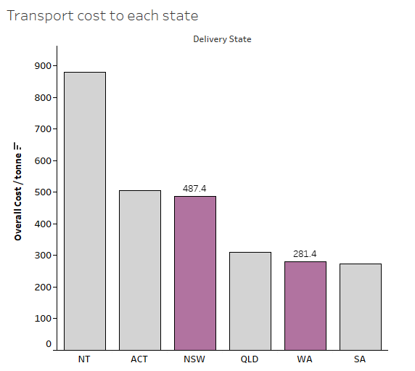
LOGISTICS COST COMPARISON
These two route we should focus
VIC - NSW
$487.4 per tonne
Close but expensive
VIC - WA
$281.4 per tonne
Far but cheap

Slide 13

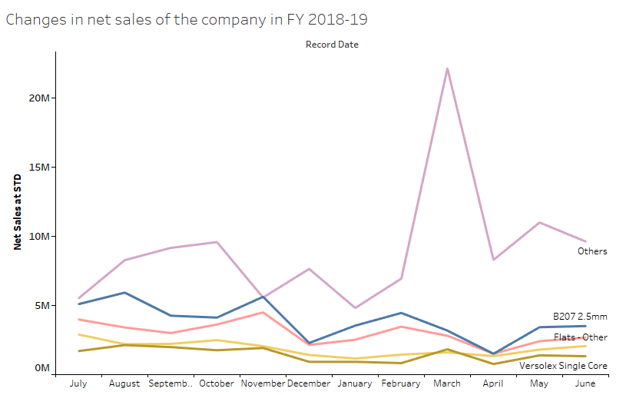
MAIN POINT 1 - GOOD TREND
Net sales of the company's main products have maintained a good performance in the past 12 months.
We can continue this trend
Produce more products that are popular with customers
Increase the total commerical margin in the future

Slide 14
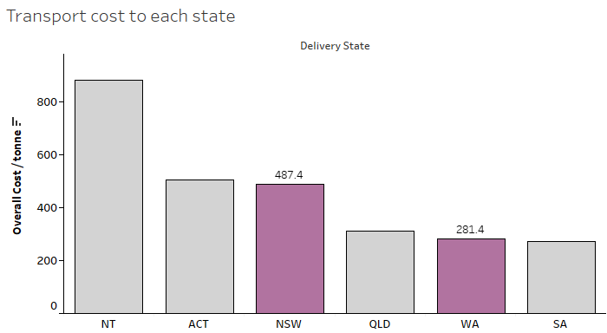
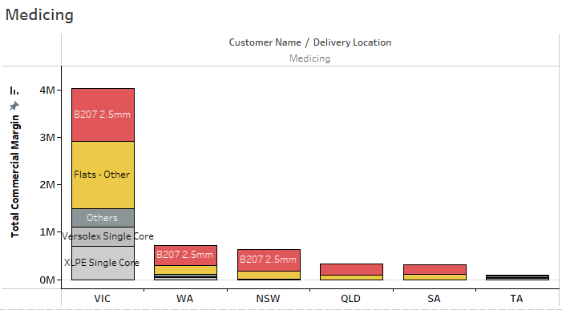
MAIN POINT 2 -PROBLEM
Higher transport costs to some states
Compare NSW and WA
Similar commercial margins and products, but transport cost are higher form VIC to NSW than to WA

Slide 15

RECOMMENDATION
AND SOLUTION
To save transport cost &
gain more potential profit
Transform part of sales from NSW to WA
Conduct more marketing activities in WA

Slide 16
Recommendation
Keep producing more popular products as they trend before
Make more profit from our marketing strategy in the future

Slide 17
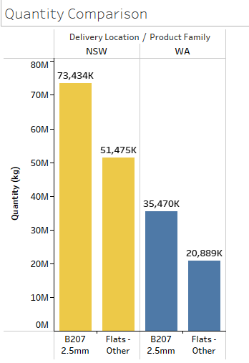
QUANTITY COMPARISON
B207 2.65mm
73,434T to NSW;
35,470T to WA
Flats-Others
51,475T to NSW;
20,889T to WA

Slide 18
POTENTIAL FINANCIAL ANALYSIS
Potential Savings up to $8.5M
Percentage of change in Sales margin from NSW to WA
Product Family Name | 20% | 25% | 30%
Product Family Name | 20% | 25% | 30%
B207 2.65mm | B207 2.65mm | $3,025,480.8 | $3,781,851 | $5,042,468
Flats﻿-Others | Flats﻿-Others | $2,120,770 | $2,650,962.5 | $3,534,616.67
Summary | Summary | $5,146,250.8 | $6,432,813.5 | $8,577,084.67

Slide 19
APPENDIX
We did data cleaning.
Removed some outliers.
Rows with Missing value
negative value are removed.

Slide 20

THANK YOU

